Slide 1
05. GAN Inversion & image Editing
2022-04-02
kts123@kookmin.ac.kr

Slide 2
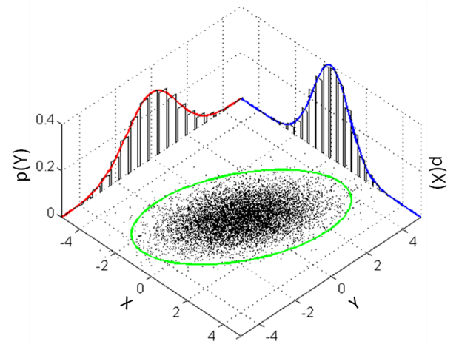
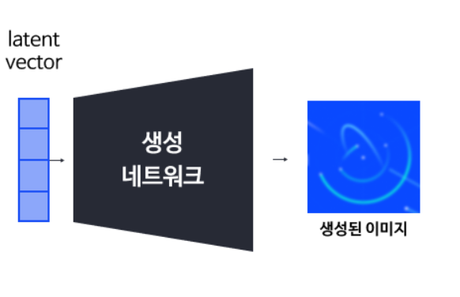
z ~ Z
x ~ X
f: z -> x
f(z) = x
z
Generator
x

Slide 3
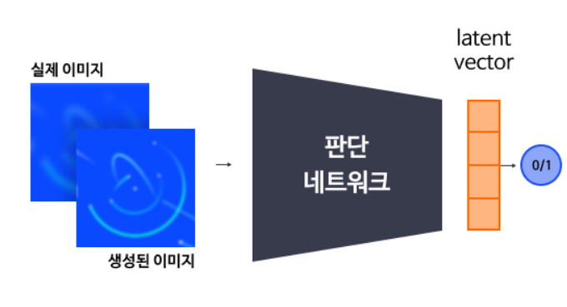
=

Slide 4
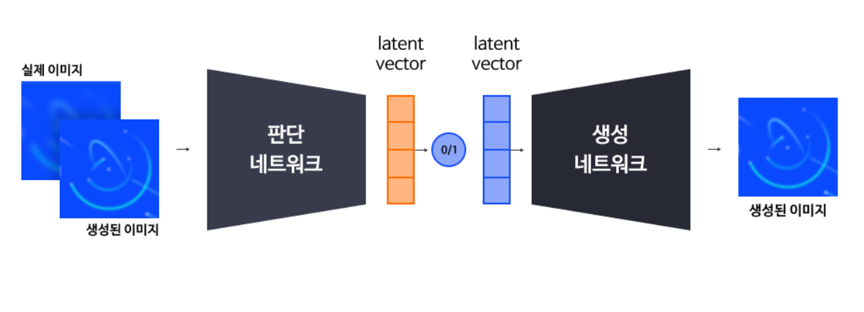
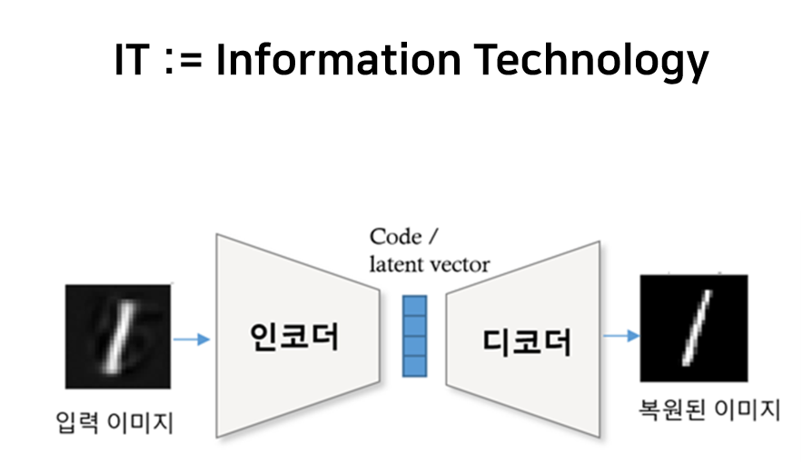
Another view

Slide 5
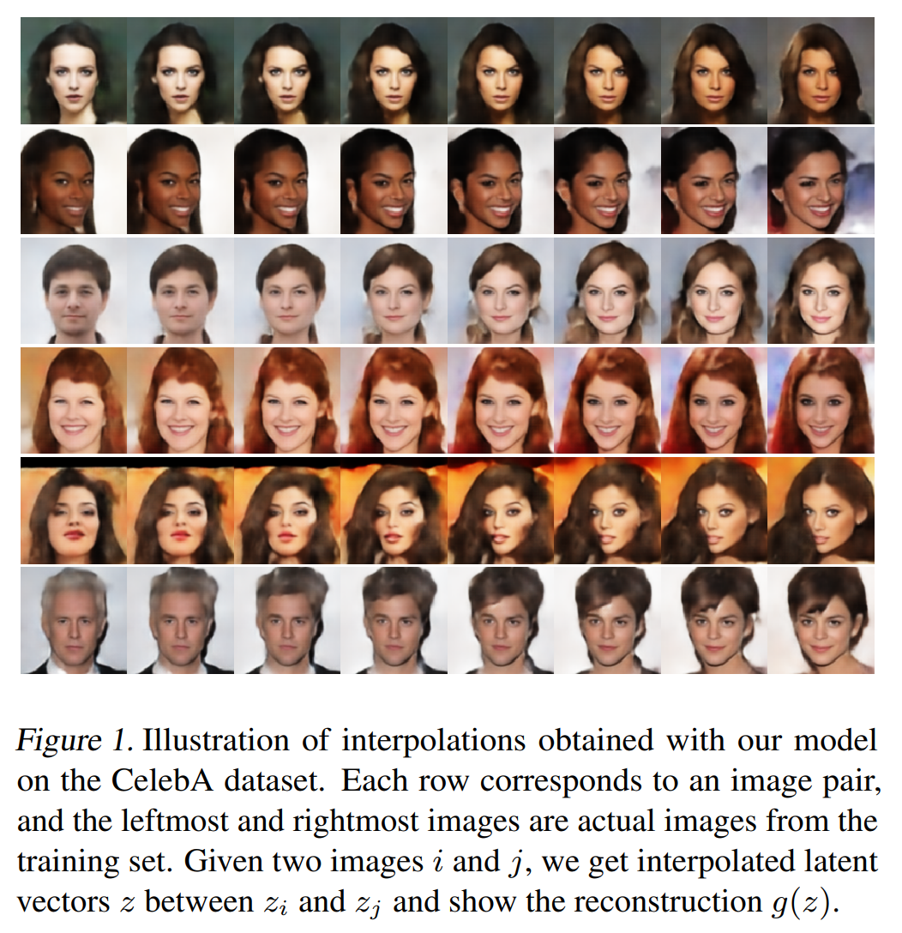
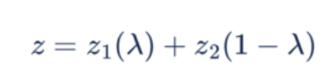
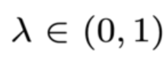
Image interpolation
https://arxiv.org/pdf/1707.05776.pdf

Slide 6
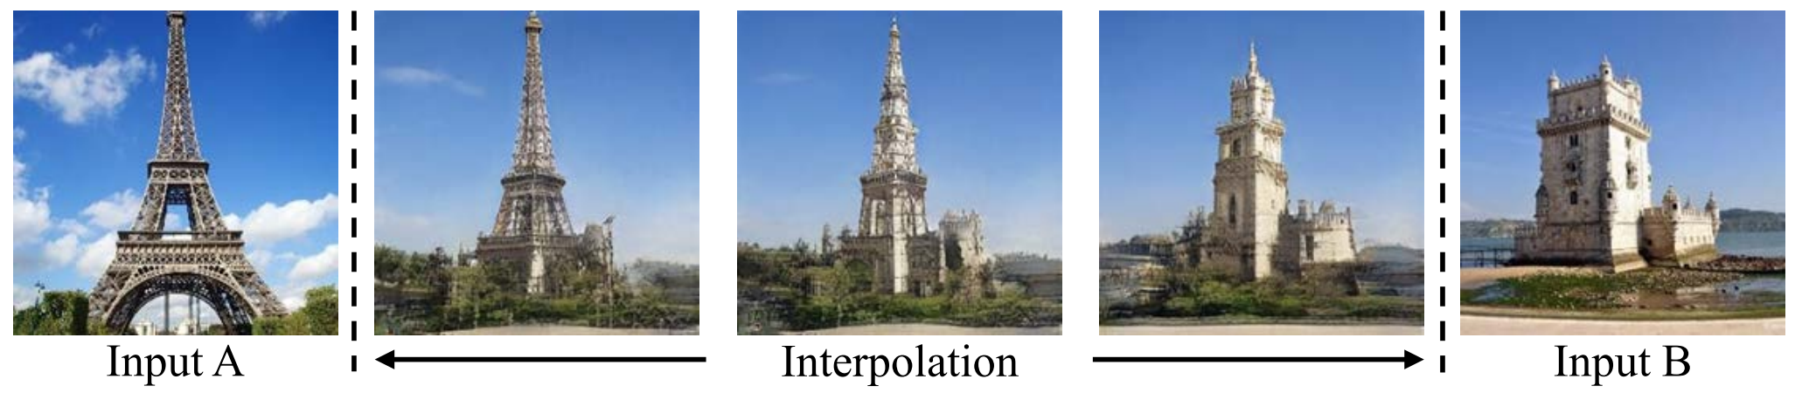
Image interpolation
https://arxiv.org/pdf/2004.00049.pdf

Slide 7
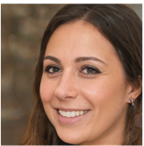
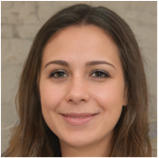
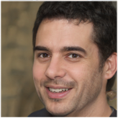
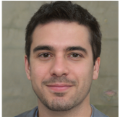
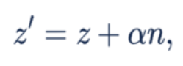
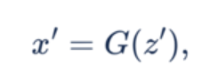
Image manipulation
Latent code 얻기
= GAN Inversion
이미지 생성하기
+ ( - )

Slide 8
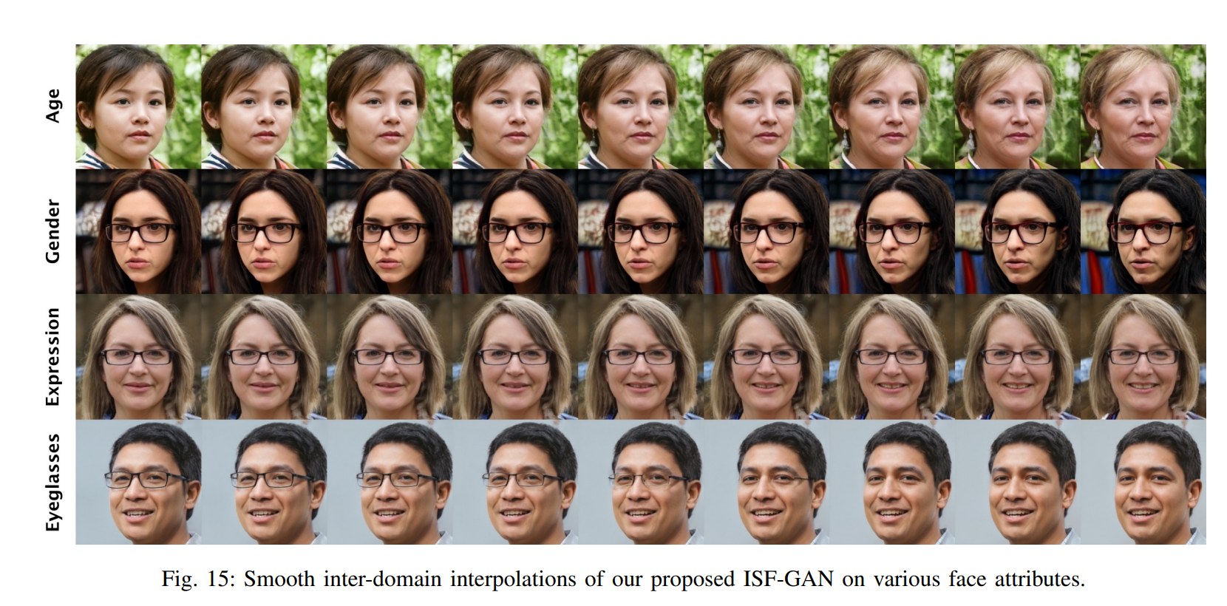
Image manipulation
https://arxiv.org/pdf/2109.12492.pdf

Slide 9
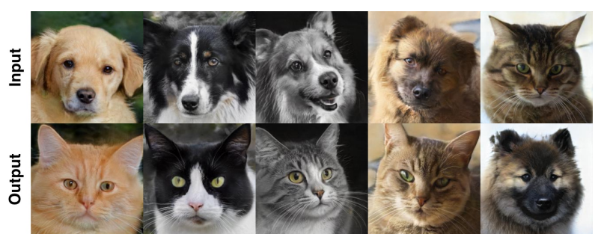
Image manipulation
https://arxiv.org/pdf/2109.12492.pdf

Slide 10
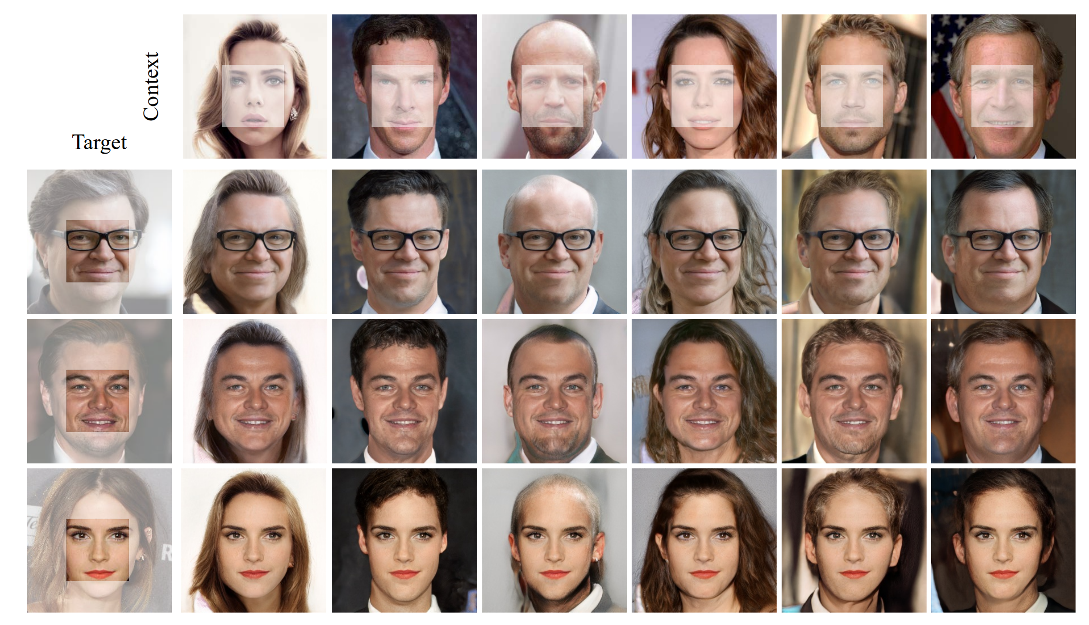
Semantic diffusion
https://arxiv.org/pdf/2004.00049.pdf

Slide 11
Latent code 얻기
= GAN Inversion
이미지 생성하기
Identity encoding
attribute encoding

Slide 12
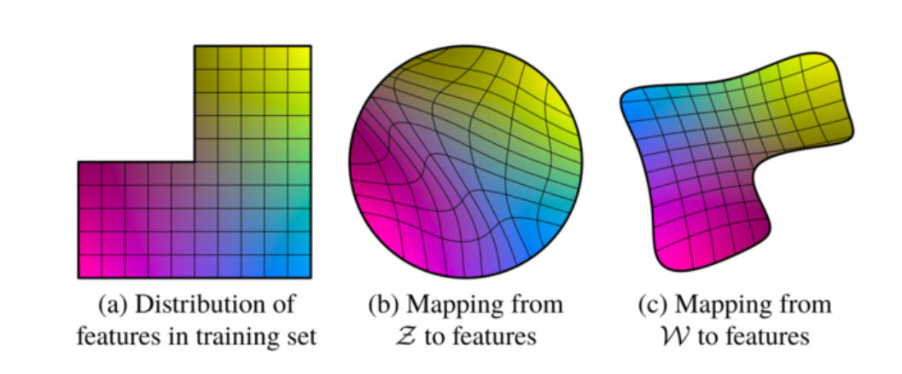
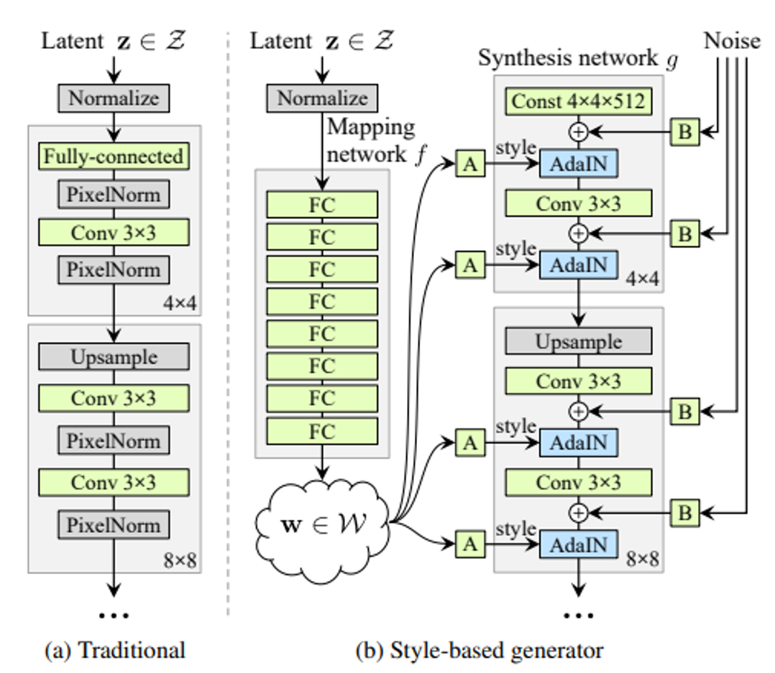
disentanglement
GAN Inversion
GAN Inversion
https://arxiv.org/pdf/1812.04948.pdf

Slide 13
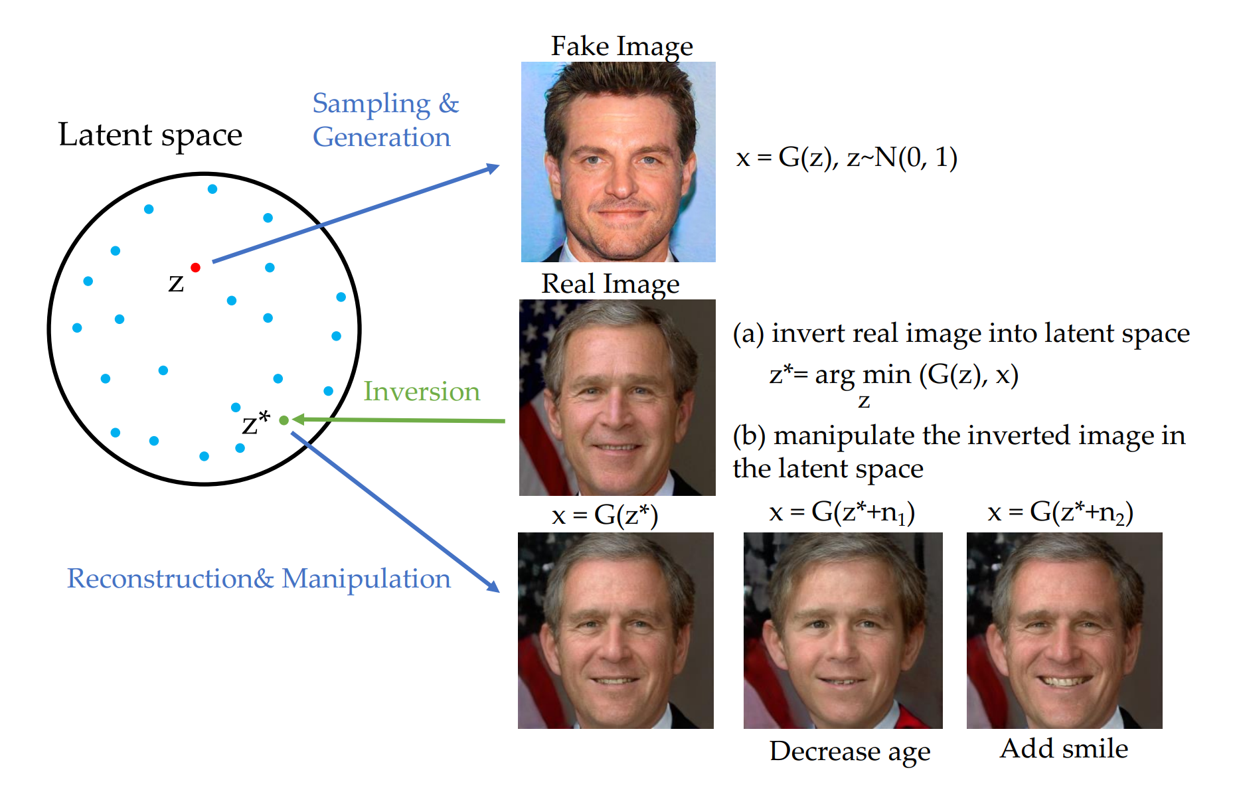
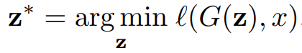
overview
https://arxiv.org/pdf/2101.05278.pdf

Slide 14
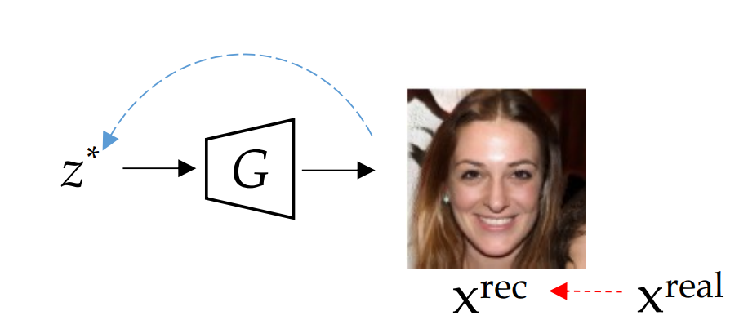
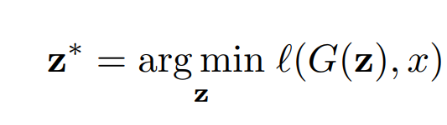
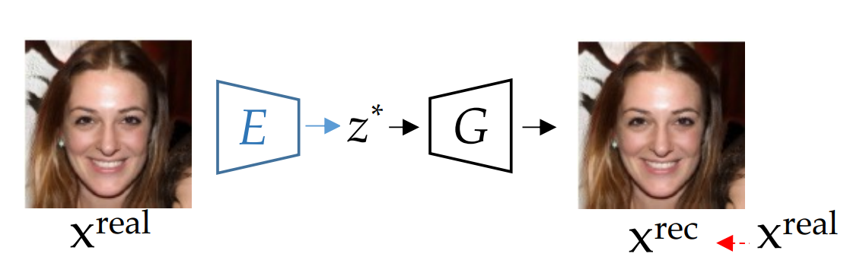
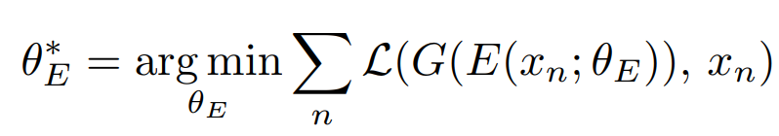
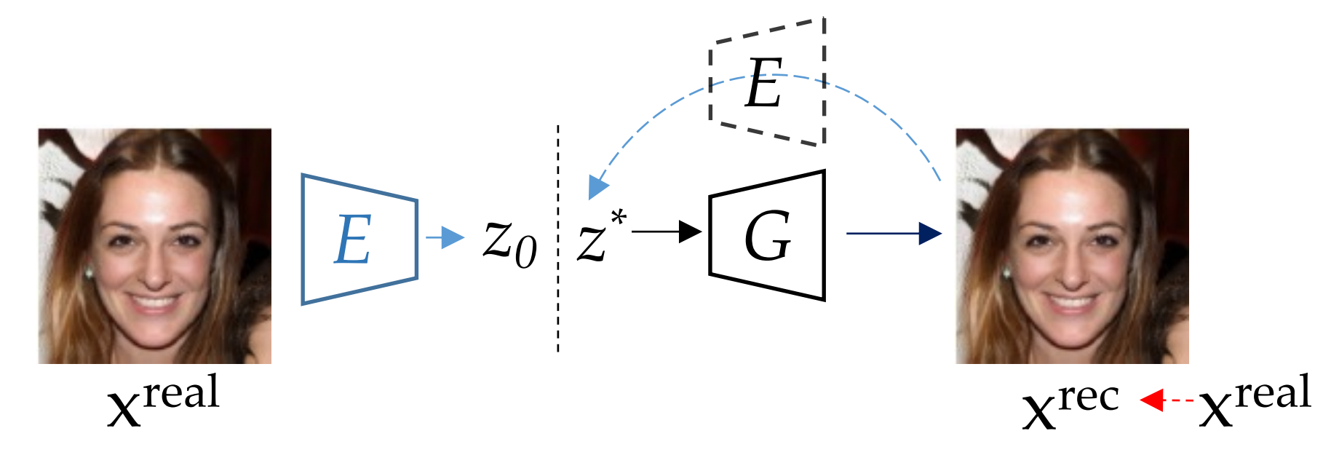
GAN Inversion Methods
https://arxiv.org/pdf/2101.05278.pdf

Slide 15
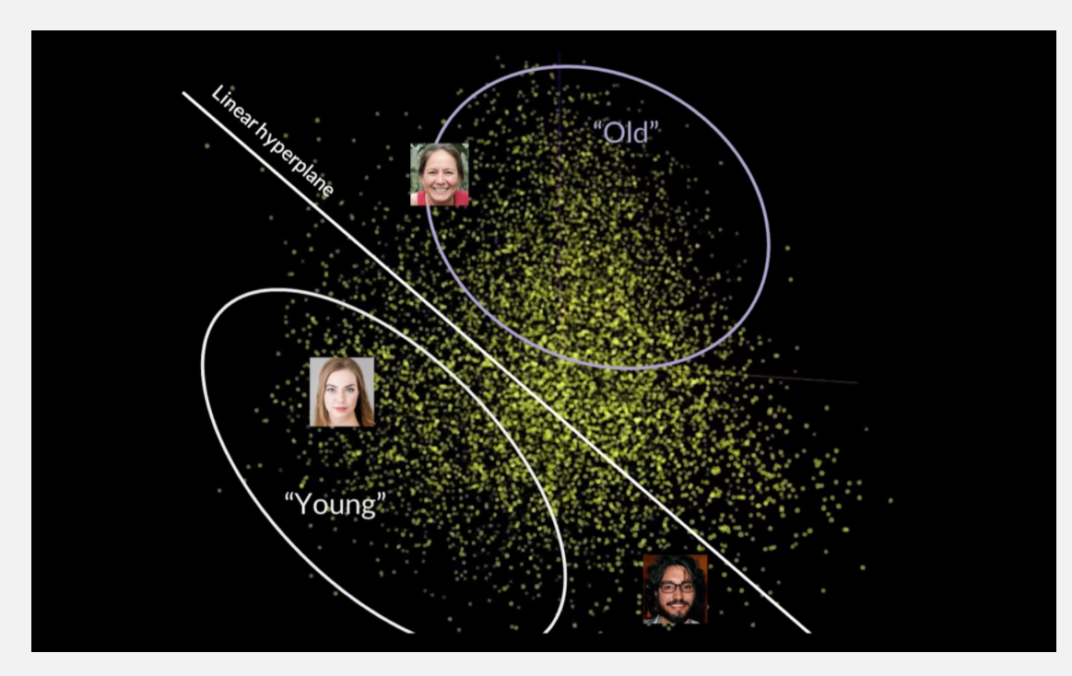
Discovering Interpretable Directions
https://datasciencelab.nl/2020/03/03/ai-for-comedy/

